Slide 1
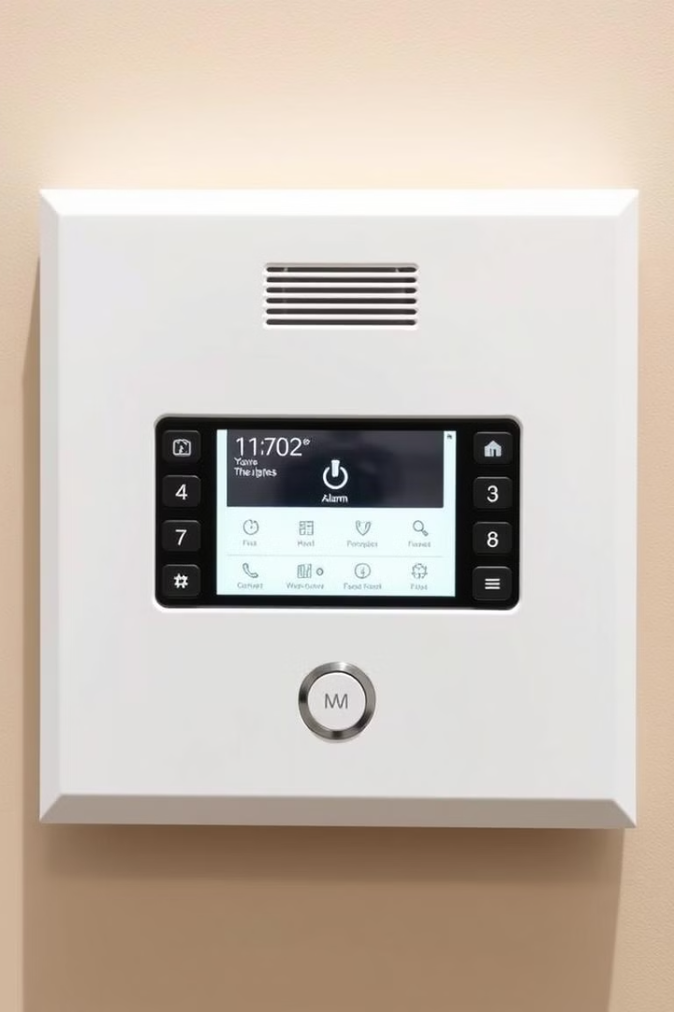
Fire Detection and Alarm System in C++
J. Sahithi(192211980)
J. Jyothi Priya(192211978)

Slide 2
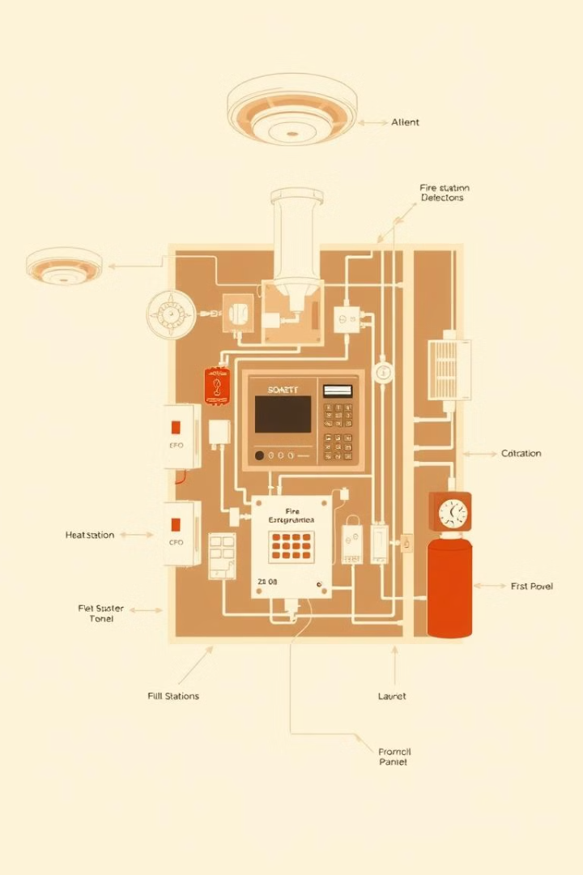
Introduction to Fire Detection and Alarm Systems
1
Rapid Response
2
Comprehensive Monitoring
Fire detection and alarm systems are designed to quickly identify and alert occupants of potential fire hazards, enabling timely evacuation and emergency response.
These systems continuously monitor for signs of fire, such as smoke, heat, and flame, in order to trigger the appropriate alarms and notifications.
3
Integrated Approach
Modern fire alarm systems integrate various sensors, control panels, and communication channels to provide a holistic solution for fire safety.
Page no:2

Slide 3
Components of a Fire Detection and Alarm System
Sensors
Control Panels
Notification Devices
Smoke detectors, heat sensors, and flame detectors are the primary means of detecting fire hazards.
The control panel acts as the brain of the system, monitoring inputs, processing data, and coordinating the appropriate response.
Sirens, strobes, and digital displays are used to alert occupants and emergency personnel of a fire incident.
Page n0:3

Slide 4
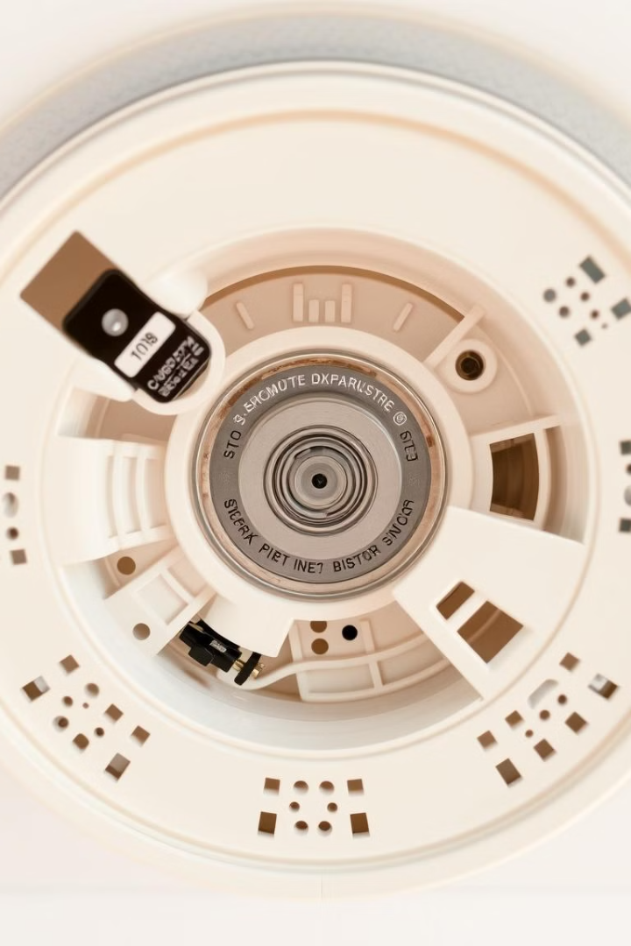
Sensor and Detection in Fire Alarm Systems
1
Smoke Detection
Smoke detectors use optical or ionization sensors to identify the presence of smoke particles, triggering the alarm system.
2
Heat Sensing
Heat detectors monitor the ambient temperature and activate the alarm when a predetermined heat threshold is exceeded.
3
Flame Sensing
Flame detectors utilize infrared or ultraviolet sensors to directly identify the presence of an open flame, providing rapid fire detection.
Page no:4

Slide 5
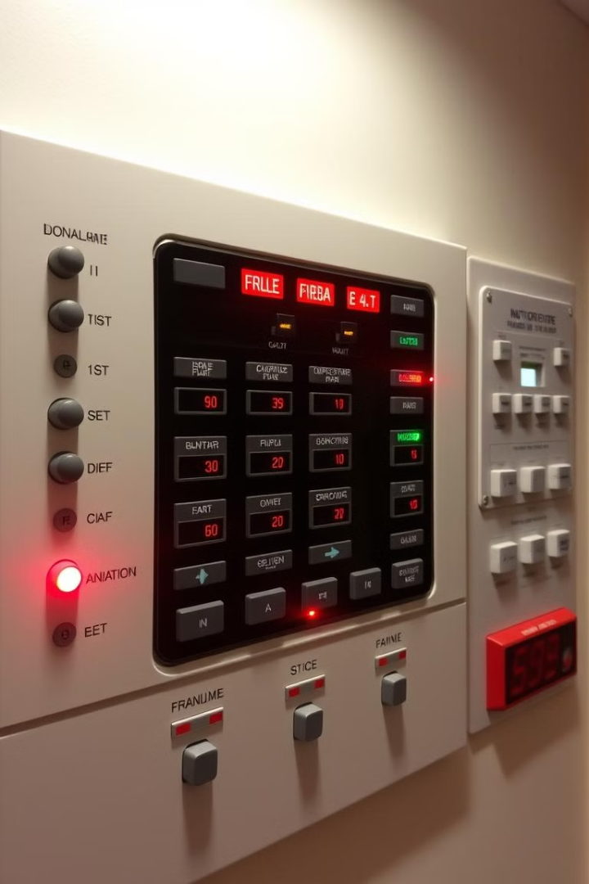
Alarm Activation and Notifications
Audible Alarms
Visual Alarms
Sirens and bells are used to alert occupants of a fire emergency, prompting them to evacuate the building.
Strobes and flashing lights provide a visual indication of a fire alarm, especially for the hearing impaired.
Remote Notifications
Automated Actions
The system can be programmed to send alert messages to emergency services, facility managers, and other relevant stakeholders.
The alarm system can be integrated with other building systems to initiate actions like closing fire doors or shutting off HVAC units.
Page no:5

Slide 6
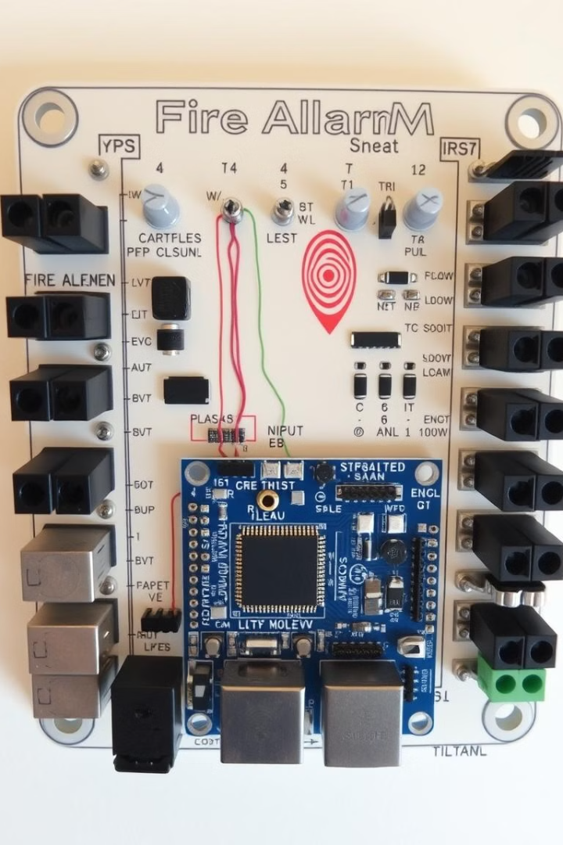




Interfacing with a Microcontroller
Sensor Integration
Control and Processing
The microcontroller receives input from various fire detection sensors, such as smoke, heat, and flame detectors.
The microcontroller processes the sensor data, applies algorithms to determine fire risk, and coordinates the appropriate response.
Alarm Activation
Monitoring and Diagnostics
The microcontroller triggers the necessary alarm systems, including audible, visual, and remote notification mechanisms.
The microcontroller can perform system diagnostics, log events, and facilitate maintenance and testing procedures.
Page no:6

Slide 7




Testing and Maintenance of the Fire Alarm System
Regular Inspections
Preventive Maintenance
Troubleshooting and Repairs
Periodic testing and inspections ensure the fire alarm system remains functional and up-to-date.
Scheduled maintenance activities, such as cleaning sensors and replacing batteries, help prevent system failures.
Prompt identification and resolution of any issues or malfunctions is crucial for maintaining the system's reliability.
Page no:7

Slide 8
Advantages and Disadvantages
Advantages
Disadvantages
Improved safety and reduced risk of fire-related incidents
Upfront installation and maintenance costs
Early detection and notification for prompt emergency response
Potential for false alarms due to system malfunctions
Dependence on a reliable power source and backup systems
Continuous monitoring and automated alarm activation
Integration with other building systems for enhanced control
Complexity in configuring and programming the system
Page no:8

Slide 9

Future Considerations
1
IoT Integration
2
Artificial Intelligence
Leveraging the Internet of Things (IoT) to enable remote monitoring, data analytics, and predictive maintenance.
Incorporating machine learning algorithms to enhance fire risk detection and optimize system performance.
3
Autonomous Response
Developing systems capable of automatically initiating emergency procedures and coordinating with first responders.
Page no:9

Slide 10

Conclusion:
Designing a comprehensive fire detection and alarm system is a crucial step in safeguarding lives and property. By leveraging C++ and integrating various sensors, control panels, and notification mechanisms, developers can create a robust and reliable system that provides early warning, coordinated response, and continuous monitoring capabilities.
Page no:10

Slide 11


